Slide 1

Internet Of Things (IoT)
Raghu Prasad
9845547471
Training Consultant
Edulife India
http://edulifeindia.com

Slide 2
Introduction
Raghu Prasad – BE, MS
Total of 24 years of experience
7 years as a lecturer in an Engineering College
17 Years into IT
Worked with companies like CISCO,CSC,ICICI,First Apex – NTT Data
Currently into Corporate training and consultancy
Worked with corporates and public sector
Service Offerings – In person/On-line/Corporate/Academic Institutes
Technologies – Java,Python,Web technologies,Java Script technologies (MEAN stack),IOT,Test Automation,Machine Learning,Artificial Intelligence,ERP,.NET
Customers – Philips,L & T,NextGen,Incarnus,Aspire system,BGS-IT,Sindhi College,Malnad Enginering College,S B College of Management, REVA University,Nagarjuna Engineering College

Slide 3

Topics
Introduction to IoT
IoT Architecture
IoT Applications
Sensors and Actuators
IoT prototyping environments
Communication protocols
IoT Consortiums
IoT Platforms
Cloud computing and data analysis
Design Considerations and IoT Security
IoT Opportunities
Demonstration

Slide 4
What is IoT ?
Internet of things (IoT) is computing concept that describes the idea of every day physical objects being connected to the internet and being able to identify themselves to other devices.
With IoT an object can represent itself digitally and communicate with other objects in unison.
IOT describes a world where just about every thing can be connected and communicate in an intelligent fashion. In other words, with IoT the physical world is becoming one big information system.
Term IoT was coined by Kelvin Ashton an expert on digital innovation
First version of internet was about data created by people and the next version is about data created by things.
Quote from Ashton in 1999 RFID Journal
“If we had computers to knew everything there was to know about things – using data they gathered without any help from us- we would be able to track and count every thing, and greatly reduce waste,loss and cost.We would know when things needed replacing, repairing or recalling and whether they were fresh or past their best”

Slide 5
IoT – Smart Refrigerator
Identification
Mobile Node
Analytics
Refrigerator
Sensors
Cloud
Gateway

Slide 6
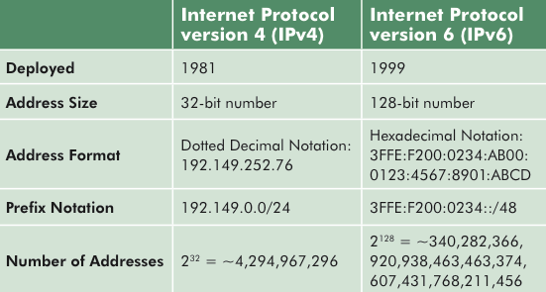
IoT – IPV4 vs IPv6

Slide 7
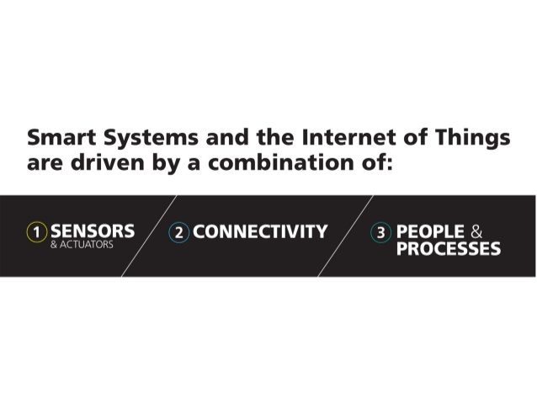
Building blocks of IoT

Slide 8
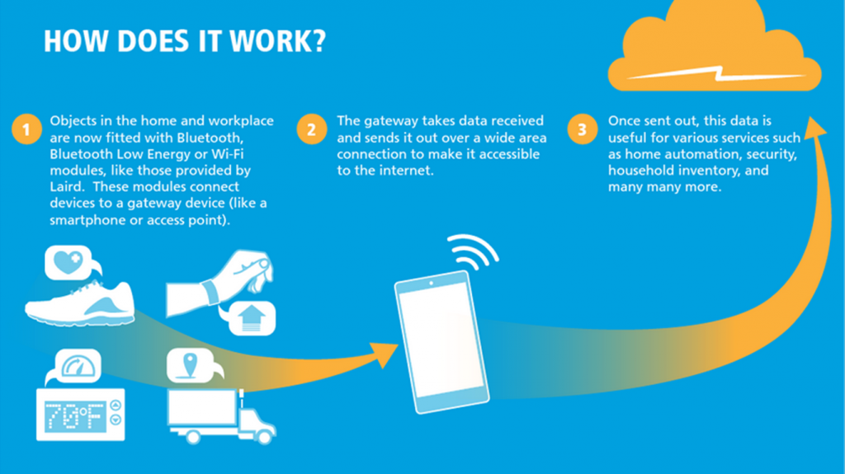
How it works ?

Slide 9
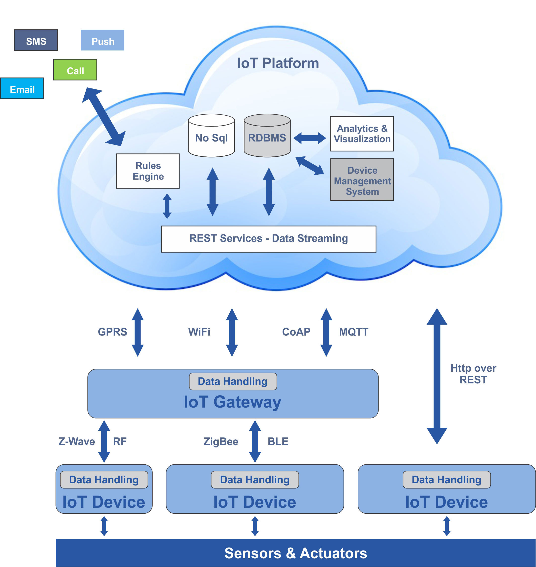
Architecture

Slide 10
Applications
Smart cities
Smart Parking
Monitoring of parking spaces availability in the city.
Structural health
Monitoring of vibrations and material conditions in buildings, bridges and historical monuments.
Noise Urban Maps
Sound monitoring in bar areas and centric zones in real time.
Smartphone Detection
Detect iPhone and Android devices and in general any device which works with WiFi or Bluetooth interfaces.
Electromagnetic Field Levels
Measurement of the energy radiated by cell stations and and WiFi routers.
Traffic Congestion
Monitoring of vehicles and pedestrian levels to optimize driving and walking routes.
Smart Lighting
Intelligent and weather adaptive lighting in street lights.
Waste Management
Detection of rubbish levels in containers to optimize the trash collection routes.
Smart Roads
Intelligent Highways with warning messages and diversions according to climate conditions and unexpected events like accidents or traffic jams.

Slide 11
Applications
Smart Environment
Forest Fire Detection
Monitoring of combustion gases and preemptive fire conditions to define alert zones.
Air Pollution
Control of CO2 emissions of factories, pollution emitted by cars and toxic gases generated in farms.
Snow Level Monitoring
Snow level measurement to know in real time the quality of ski tracks and allow security corps avalanche prevention.
Landslide and Avalanche Prevention
Monitoring of soil moisture, vibrations and earth density to detect dangerous patterns in land conditions.
Earthquake Early Detection
Distributed control in specific places of tremors.

Slide 12
Applications
Smart water
Potable water monitoring
Monitor the quality of tap water in cities.
Chemical leakage detection in rivers
Detect leakages and wastes of factories in rivers.
Swimming pool remote measurement
Control remotely the swimming pool conditions.
Pollution levels in the sea
Control realtime leakages and wastes in the sea.
Water Leakages
Detection of liquid presence outside tanks and pressure variations along pipes.
River Floods
Monitoring of water level variations in rivers, dams and reservoirs.

Slide 13
Applications
Smart Metering
Smart Grid
Energy consumption monitoring and management.
Tank level
Monitoring of water, oil and gas levels in storage tanks and cisterns.
Photovoltaic Installations
Monitoring and optimization of performance in solar energy plants.
Water Flow
Measurement of water pressure in water transportation systems.
Silos Stock Calculation
Measurement of emptiness level and weight of the goods.

Slide 14
Applications
Security and emergencies
Perimeter Access Control
Access control to restricted areas and detection of people in non-authorized areas.
Liquid Presence
Liquid detection in data centers, warehouses and sensitive building grounds to prevent break downs and corrosion.
Radiation Levels
Distributed measurement of radiation levels in nuclear power stations surroundings to generate leakage alerts.
Explosive and Hazardous Gases
Detection of gas levels and leakages in industrial environments, surroundings of chemical factories and inside mines.

Slide 15
Applications
Retail
Supply Chain Control
Monitoring of storage conditions along the supply chain and product tracking for traceability purposes.
NFC Payment
Payment processing based in location or activity duration for public transport, gyms, theme parks, etc.
Intelligent Shopping Applications
Getting advices in the point of sale according to customer habits, preferences, presence of allergic components for them or expiring dates.
Smart Product Management
Control of rotation of products in shelves and warehouses to automate restocking processes.

Slide 16
Applications
Logistics
Quality of Shipment Conditions
Monitoring of vibrations, strokes, container openings or cold chain maintenance for insurance purposes.
Item Location
Search of individual items in big surfaces like warehouses or harbours.
Storage Incompatibility Detection
Warning emission on containers storing inflammable goods closed to others containing explosive material.
Fleet Tracking
Control of routes followed for delicate goods like medical drugs, jewels or dangerous merchandises.

Slide 17
Applications
Industrial Control
M2M Applications
Machine auto-diagnosis and assets control.
Indoor Air Quality
Monitoring of toxic gas and oxygen levels inside chemical plants to ensure workers and goods safety.
Temperature Monitoring
Control of temperature inside industrial and medical fridges with sensitive merchandise.
Ozone Presence
Monitoring of ozone levels during the drying meat process in food factories.
Indoor Location
Asset indoor location by using active (ZigBee) and passive tags (RFID/NFC).
Vehicle Auto-diagnosis
Information collection from CanBus to send real time alarms to emergencies or provide advice to drivers.

Slide 18
Applications
Smart Agriculture
Wine Quality Enhancing
Monitoring soil moisture and trunk diameter in vineyards to control the amount of sugar in grapes and grapevine health.
Green Houses
Control micro-climate conditions to maximize the production of fruits and vegetables and its quality.
Golf Courses
Selective irrigation in dry zones to reduce the water resources required in the green.
Meteorological Station Network
Study of weather conditions in fields to forecast ice formation, rain, drought, snow or wind changes.
Compost
Control of humidity and temperature levels in alfalfa, hay, straw, etc. to prevent fungus and other microbial contaminants.

Slide 19
Applications
Smart Animal Forming
Hydroponics
Control the exact conditions of plants grown in water to get the highest efficiency crops.
Offspring Care
Control of growing conditions of the offspring in animal farms to ensure its survival and health.
Animal Tracking
Location and identification of animals grazing in open pastures or location in big stables.
Toxic Gas Levels
Study of ventilation and air quality in farms and detection of harmful gases from excrements.

Slide 20
Applications
Home Automation
Energy and Water Use
Energy and water supply consumption monitoring to obtain advice on how to save cost and resources.
Remote Control Appliances
Switching on and off remotely appliances to avoid accidents and save energy.
Intrusion Detection Systems
Detection of windows and doors openings and violations to prevent intruders.
Art and Goods Preservation
Monitoring of conditions inside museums and art warehouses.

Slide 21
Applications
eHealth
Fall Detection
Assistance for elderly or disabled people living independent.
Medical Fridges
Control of conditions inside freezers storing vaccines, medicines and organic elements.
Sportsmen Care
Vital signs monitoring in high performance centers and fields.
Patients Surveillance
Monitoring of conditions of patients inside hospitals and in old people's home.
Ultraviolet Radiation
Measurement of UV sun rays to warn people not to be exposed in certain hours.

Slide 22
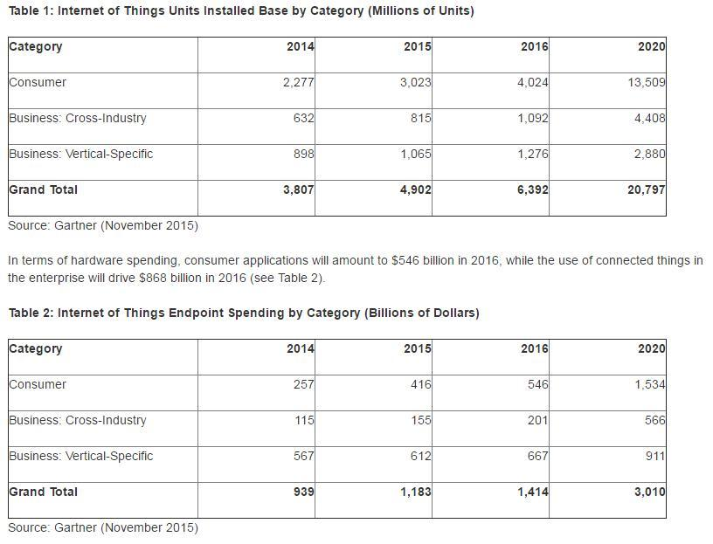
IoT Market
Gartner predicts 6.4B connected things will be in use worldwide in 2016, up 30% from 2015, and will reach 20.8 billion by 2020. In 2016, 5.5 million new things will get connected every day.

Slide 23
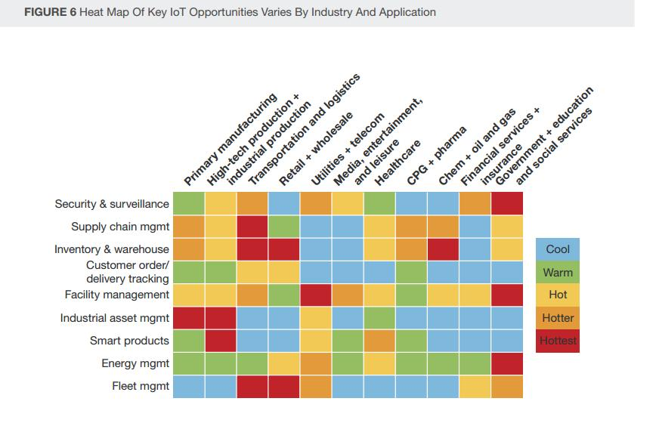
IoT Market

Slide 24
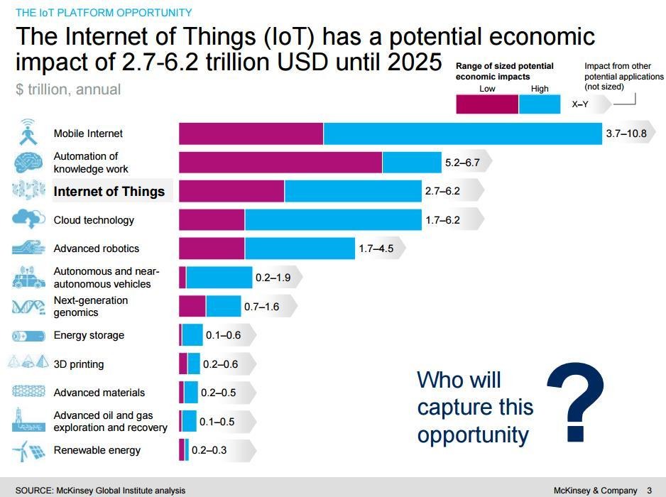
IoT Market

Slide 25
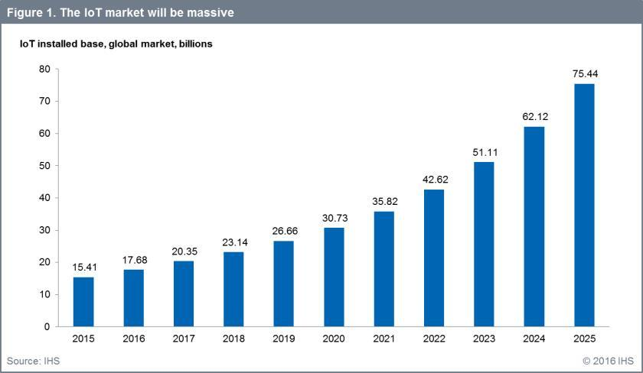
IOT Market
IHS forecasts that the IoT market will grow from an installed base of 15.4 billion devices in 2015 to 30.7 billion devices in 2020 and 75.4 billion in 2025

Slide 26
Sensors & Actuators
Sensors have been in existence since the beginning of civilization (Viking Compass)
With the advent of technology new age sensors started sensing like human beings.
A sensor is a device that detects and responds to some type of input from the physical environment
Output is generally a signal that is converted to human readable display at the sensor location or transmitted electronically over a network for further processing
Sensors in Android mobile phones
Motion sensors – Accelerometer,gravity sensors,gyroscopes,rotational vector sensors
Environmental sensors – temperature,pressure,illumination and humidity
Position sensors – orientation sensor and magnetometers
APP- Sensor Box for Android. Sensors https://developer.android.com/guide/topics/sensors/sensors_overview.html
iPhone – NFC for autopay
RFID – Radio Frequency Identification uses electro magnetic field to automatically identify and track objects attached to objects. Tags could be active or passive (read only).Exitor.300 MHz to 3 GHz
Usage – Access management,tracking of goods,tracking of animals,toll collection, contact less payment,airport baggage tracking,inventory management
BLE Beacon (Blue tooth low energy) engage with end users via mobile app for ex shopping,museums,Refreshment, at stadium,home automation Transferes unique identification. 2.4 GHz
NFC (Near Field Communication) typically used for cashless payment Apple Pay,Android pay,Google wallet (10 cms,read and write). Pair devices. 13.56 MHz. Badge.Restaurant menu,Feedback form. 70 mtr

Slide 27
Sensors
Sensors
Acoustic/Sound/Vibration
Position/Presence/Proximity
Motion/Velocity/Displacement
Temperature
Humidity/Moisture
Chemical/Gas
Flow
Force/Load/Torque/Pressure
Leaks/Levels
Electric/Magnetic
Acceleration/Tilt/Light

Slide 28
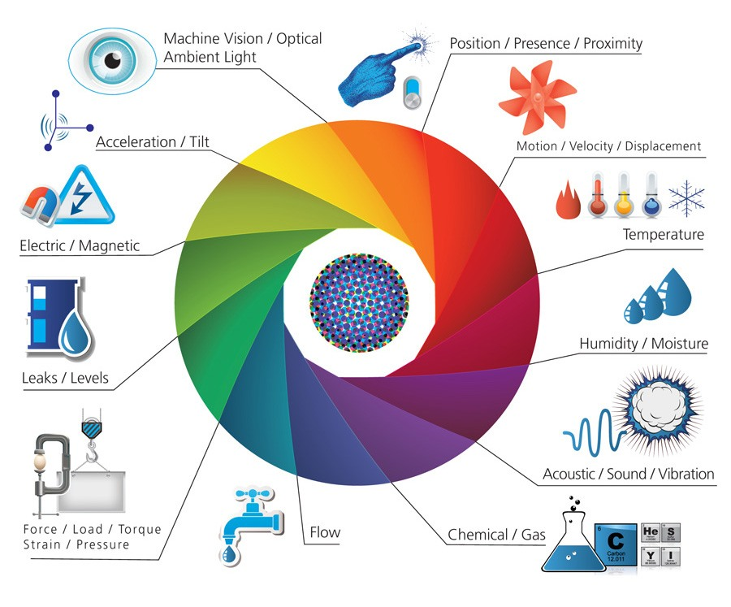
Sensors - Examples

Slide 29
Sensors - Examples
Acoustic/Sound/Vibration – Hydrophone,Seismometer,Microphone
Automotive/Transportation sensor – Blind spot monitor,Curb feeler,Defect Detector,Engine coolant temperature sensor,parking sensor,Speed sensor
Chemical sensor – Breathanalyzer,Corbon dioxide sensor,Hydrogen sensor,Smoke detector,
Environment,weather,moisture, humidity sensor – Ceilometer,Fish counter,Gas detector,Hygrometer,Leaf sensor,Pyrgeometer,Rain gauge,
Flow,Fluid velocity sensor – Air flow meter,Anemometer,Flow sensor,Mass flow sensor
Optical,light,imaging,photo sensor – Flame detector,Optical position sensor,photo electric sensor
Proximity,presence sensor – Motion detector,Occupancy sensor,Proximity sensor,
Electric current, Electric potential,magnetic,radio sensor – Current sensor,Metal detector,Radio direction finder
Sensor Further Information – https://en.wikipedia.org/wiki/List_of_sensors
https://www.youtube.com/watch?v=2bcXeQ_PA6I
https://www.youtube.com/watch?v=bPMN4I9IZTA
https://www.youtube.com/watch?v=ht-_RmhLD7k https://www.youtube.com/watch?v=c43hmt_-7d8

Slide 30
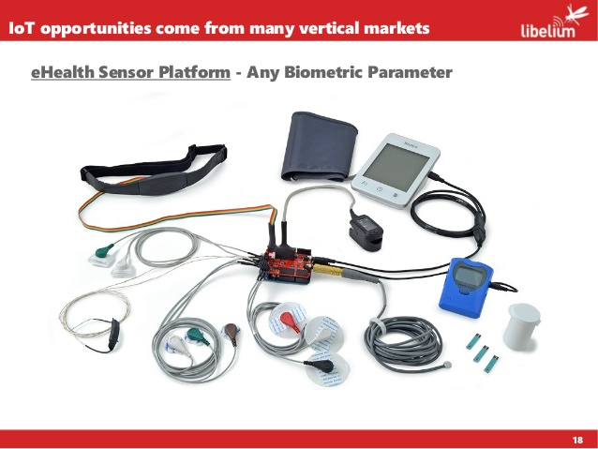
Sensors - kits

Slide 31
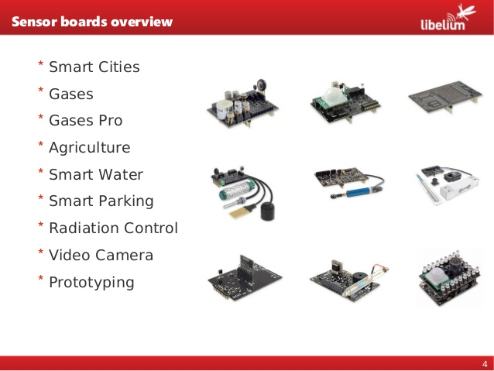
Sensors - kits

Slide 32
Actuators
Actuators
Is a mechanism of turning energy into motion
Types of actuators based on source of energy
Manual or mechanical
Levers/Jacks
Hydraulic/Pneumatic
Pistons/Valves
Thermal
Bimetallic Switch
Electric
Motors/Resonators

Slide 33
Good sensor
Is sensitive to measured property only
Does not influence the measured property
Is sturdy and compact

Slide 34
Sensor properties
Sensor Range – Minimum and Maximum values
Bias – Offset – Output of a sensor at zero input
Non Linearity – Amount of output differs from ideal behaviour
Dynamic error – Deviation in reading caused by rapid change of the measured property over time
Drift – If the output signal slowly changes independent of the measured property
Noise – Random deviation that varies in time
Digitization error – output is the approximation of the measured property
https://www.youtube.com/watch?v=_GtLK3KyoJk

Slide 35
Top Sensor manufacturers
ST Micro Electronics
Bosch
Texas Instruments
HP
Knowles
DeltaOHM
Futek
All Sensors,Omron,TSI,OXIGRAPH,ESIS
Thomas Products,Central States Group,EZ Meter,Environmend
Kaylee Controls,Kamboj Enterprises,Kaizen Imperial,Asiatech

Slide 36
Market place for IoT
India mart
https://my.indiamart.com/
ST Micro Electronics
http://www.st.com/content/st_com/en.html
Bosch
https://www.bosch.com/products-and-services/connected-products-and-services/industry-4-0/
Texas Instruments http://www.ti.com/ww/en/internet_of_things/iot-products.html

Slide 37
IoT Prototyping environment
Arduino
Arduino is an open-source platform used for building electronics projects. Arduino consists of both a physical programmable circuit board (often referred to as a microcontroller) and a piece of software, or IDE (Integrated Development Environment) that runs on your computer, used to write and upload computer code to the physical board.
The Arduino platform has become quite popular with people just starting out with electronics, and for good reason. Unlike most previous programmable circuit boards, the Arduino does not need a separate piece of hardware (called a programmer) in order to load new code onto the board – you can simply use a USB cable. Additionally, the Arduino IDE uses a simplified version of C++, making it easier to learn to program. Finally, Arduino provides a standard form factor that breaks out the functions of the micro-controller into a more accessible package.
Arduino board family
Arduino Uno
Arduino Mega
Lily Pad Arduino
https://learn.sparkfun.com/tutorials/what-is-an-arduino

Slide 38

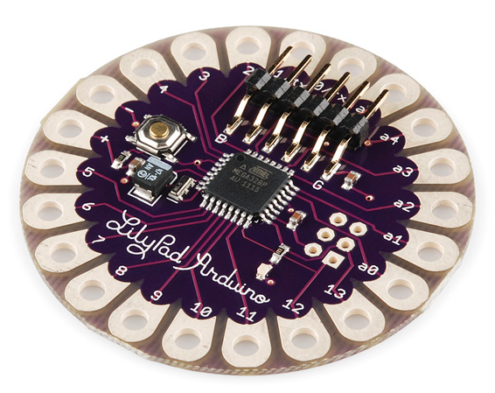
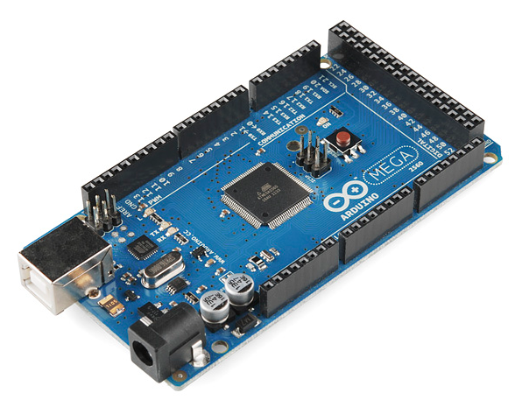
Arduino - flavours

Slide 39
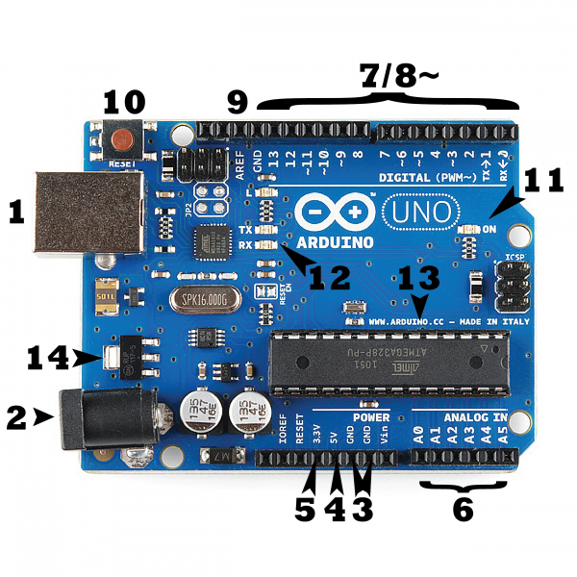
Arduino Uno – Deep drive

Slide 40
Arduino Uno – Deep drive
1 – Power through USB
2 – Power through Barrel Jack (DC – 6 to 12 volts)
PINS
3 – Ground
4 – 5 Volt power
5 – 3.5 Volt power
6 - A0 to A5 Analog pig
7 - Digital pin 0 through 13
8 – Pulse Width Modulation (PWM) - simulate analog output (like fading an LED in and out).
9 – Analog Reference - Most of the time you can leave this pin alone. It is sometimes used to set an external reference voltage (between 0 and 5 Volts) as the upper limit for the analog input pins.
10 – Reset Button
11 – Power Led Indicator
12 – RX/TX indicator LED’s - These LEDs will give us some nice visual indications whenever our Arduino is receiving or transmitting data (like when we’re loading a new program onto the board).
13 – Integrated Chip (IC) – Atmega
14 – Voltage Regulator

Slide 41
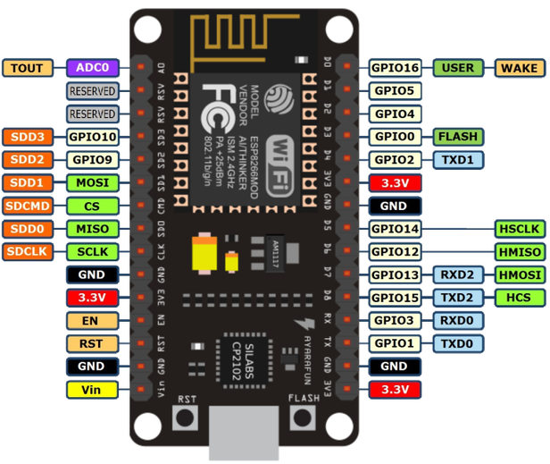
NodeMCU(ESP 8266)-Amica

Slide 42
NodeMCU(ESP 8266)-Amica
While writing GPIO code on NodeMCU, you can’t address them with actual GPIO Pin Numbers. There are different I/O Index numbers assigned to each GPIO Pin which is used for GPIO Pin addressing. Refer following table to check I/O Index of NodeMCU GPIO Pins –
Installation - http://esp8266.github.io/Arduino/versions/2.0.0/doc/installing.html

Slide 43
NodeMCU(ESP 8266)-Amica
GPIO Pin | I/O Index Number
GPIO0 | 3
GPIO1 | 10
GPIO2 | 4
GPIO3 | 9
GPIO4 | 2
GPIO5 | 1
GPIO6 | N/A
GPIO7 | N/A
GPIO8 | N/A
GPIO9 | 11
GPIO10 | 12
GPIO11 | N/A
GPIO12 | 6
GPIO13 | 7
GPIO14 | 5
GPIO15 | 8
GPIO16 | 0

Slide 44
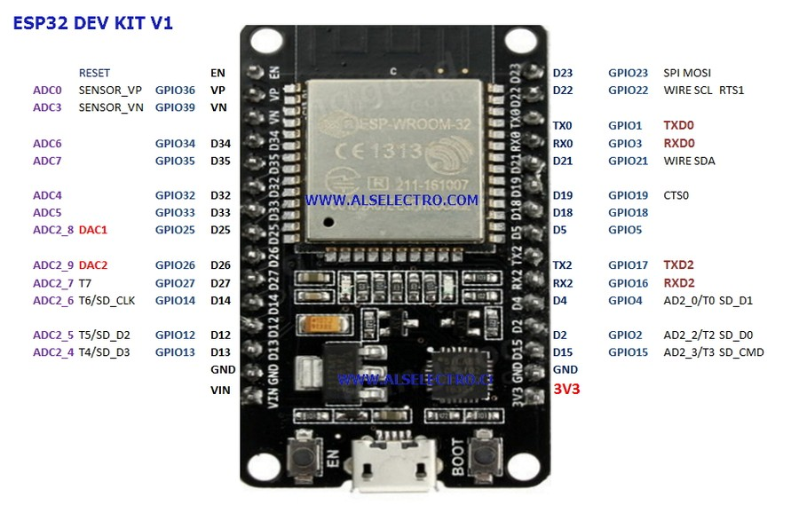
ESP32 DEV KIT V1

Slide 45
IoT Protocols
What is a protocol ?
Special set of rules that end points in a telecommunication connection use when they communicate. Protocols specify interaction between the communicating entities.
Protocol | Technology | Standard
A network protocol defines rules and conventions for communication between network devices | Activity of designing and constructing and maintaining communication system | A standard is a document that specifies something that has the overwhelming support and agreement of the standards making body
Examples Protocols | Examples of Technology | Examples of standard
IP TCP UDP FTP HTTP MQTT COAP | Wi-Fi Bluetooth ZigBee NFC WiMax GSM CDMA | IEEE 802.11 a/b/g (WiFi,Bluetooth) 802.15 (ZigBee,NFC,GSM) 802.16

Slide 46
IoT Protocols
IoT end node/device requirements
Scalable
Secure
End node addressability
Low power
Limited memory
Low cost
Lightweight connection

Slide 47
Communication Technologies
ZigBee
Z-wave
Bluetooth
Bluetooth Low Energy (BLE)
Wi-Fi
Cellular
6LowPAN
LoRaWAN
Sigfox

Slide 48

ZigBee
ZigBee
Low data rate,Low power consumption,Small pocket devices,Unlicensed bands
Bands (ISM – The industrial, scientific, and medical radio band)
ISM 2.4 GHz Global band at 250 kbps
868 MHz European band at 20 kbps
915 MHz North American band at 40 kbps
Range is very low – 100 to 300 ft
Topologies
Mesh,Star,One to One
Usage
Building automation,Health care,Asset management,Consumer electronics,Lawn and garden irrigation

Slide 49
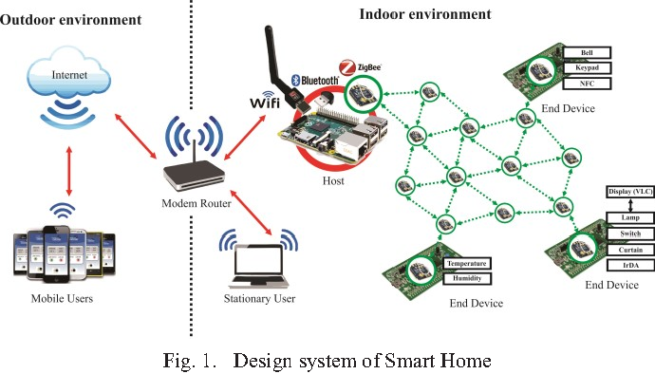
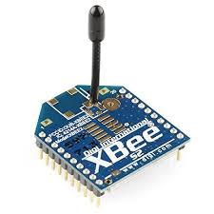
ZigBee

Slide 50
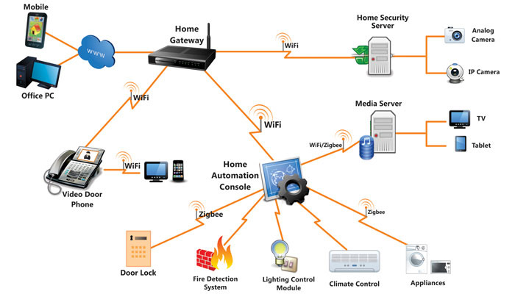
ZigBee

Slide 51
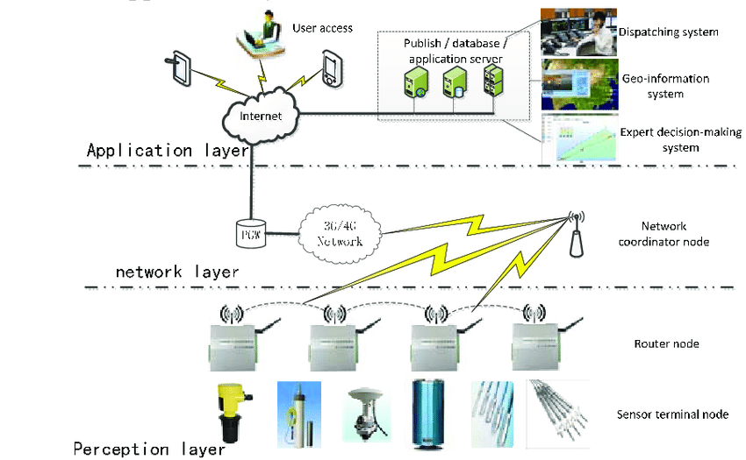
ZigBee

Slide 52
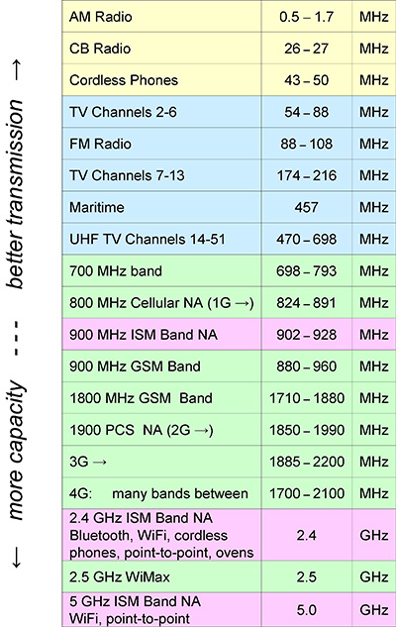
ISM bands

Slide 53
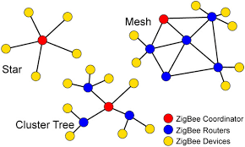
ZigBee - Network
Network topology

Slide 54
Z-Wave
Z-Wave
Oriented towards residential control and automation market
Bands
Works in sub Giga hertz frequency band – 900 MHz,100 kbps
Can have a maximum of 232 nodes
Topologies
Operates on mesh network architecture with one primary and multiple secondary controllers
USP is interoperability

Slide 55
Bluetooth
Bluetooth
Open standard for development of Personal Area Network (PAN)
Low cost,low power, short range (with in 10 meters)
Bluetooth enabled device can exchange information (transfer data) with other bluetooth device over a radio
Bluetooth helps in creating small network of devices that are close to one another
Bluetooth Low Energy (BLE)
Integral part of Bluetooth specification from Bluetooth V4.0 onwards
Low power consumption
Wearables, home automation, Health and wellness, Sports and fitness

Slide 56
BLE
Bluetooth Tooth Low Energy
Integral part of Bluetooth core specification from v4.0 onwards
Range : ~150 mtrs open field
Output power: ~10 mW
Max Current: ~15 mA
Topology: Star
Connection : >2 billlon
Modulation : GFSK @2.4 GHz
Security : 128 bit AES CCM

Slide 57
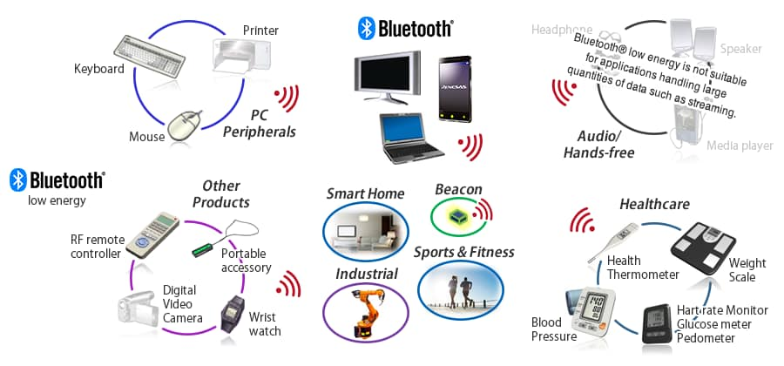
BLE - Applications
BLE and Bluetooth Tooth applications

Slide 58
Wi-Fi
Wi-Fi
Widely used
Standard – 802.11 n
Frequencies – 2.4 to 5 GHz
Range – 50 m
Data rates – 600 Mbps max. Typically between 150 to 200 Mbps
http://beta.speedtest.net

Slide 59
Cellular
Cellular
IOT application require to operate over longer distance can use GSM/3G/4G
Standard – GSM/GPRS/Edge (2G)/UMTS/HSPA (3G)/LTE (4G)
Frequencies – 900/1800/1900/2100 MHz
Range – 35 kms max for GSM,200 Kms for HSPA
Data rates (typical download)– 35 to 170 kbps (GPRS),120 to 384 kbps (EDGE),384 kbps to 2 Mbps (UMTS),600 kbps to 10 Mbps ( HSPA), 3 to 10 Mbs (LTE)

Slide 60
6LoWPAN
6LoWPAN
IPv6 over low power Wireless Personal Area Network. Works with Mesh architecture
A simple low cost wireless network of devices that have limited power and relaxed throughput requirements
Has the capability to connect to internet
Confirms to 802.15.4-2003
It is an adaption layer for IPv6 over IEEE802.15.4 links

Slide 61
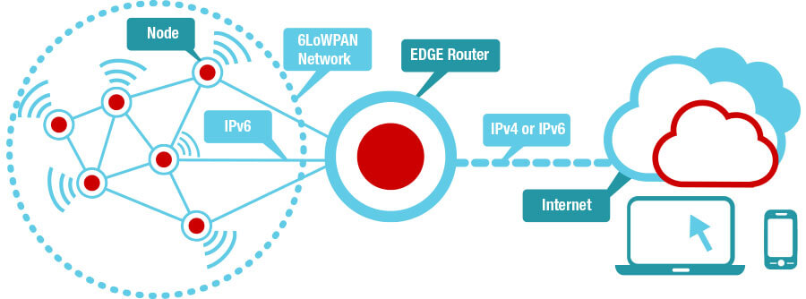
6LoWPAN

Slide 62
6LoWPAN
Nodes
(Self-healing mesh, routers and hosts)
From light bulbs to smoke detectors, each node carries an IPv6 address. Nodes typically require small amounts of memory and processing power, and can be implemented using a wireless microcontroller (MCU).
EDGE router
(Simple IP router, no-application-layer gateway)
The compressed IPv6 header needs an intermediary device to provide a conversion between 6LoWPAN and standard IP header. An EDGE router can be seen as this simplified “gateway”. This can be a standalone or an add-on system.
Internet
Connect to any cloud. TI is partnering with many cloud service providers to provide a simple and direct way to get you to the cloud.

Slide 63
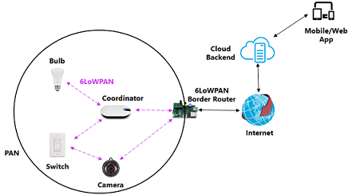
6LoWPAN

Slide 64
Sigfox
Sigfox
Range comes between WiFi and Cellular
Uses ISM bands which is free and no license is required
Ideal for devices having low level of data transfer and communication should be less expensive
Frequency – 900 MHz
Range – 30 to 50 kms Rural, 3 to 10 kms Urban
Data Range – 10 to 1000 bps

Slide 65
LoRaWAN
LoRaWAN targets wide-area network (WAN) applications and is designed to provide low-power WANs with features specially needed to support low-cost mobile secure bi-directional communication in IOT,M2M and smart city and industrial applications
Optimized for low-power consumption and supporting large networks with millions and millions of devices,data rates rages from 0.3 kbps to 50 kbps.
Standard:LoRaWAN
Frequency :Various
Range: 2-5 km (urban environment), 15 km(suburban environment)
Data Rates:0.-50 kpbs

Slide 66
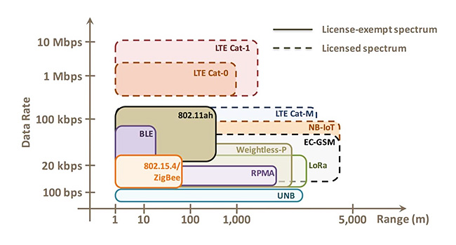
Range vs Data rate

Slide 67
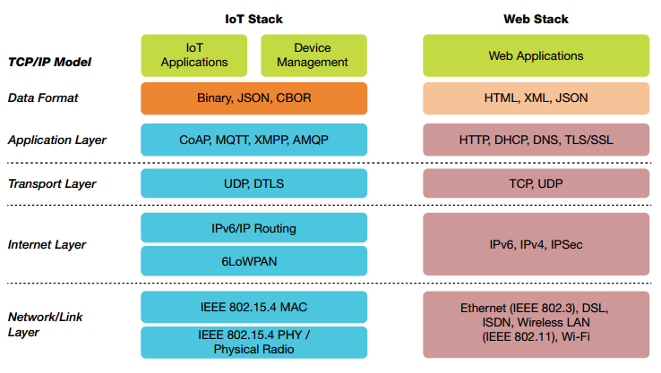
IOT - Protocols

Slide 68
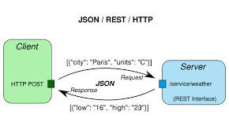
Restful HTTP

Slide 69
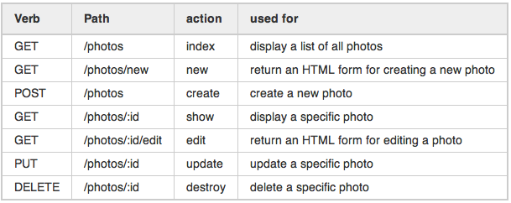
Restful HTTP

Slide 70
Restful HTTP – Hands-on
https://jsonplaceholder.typicode.com/
https://openweathermap.org/api
http://api.openweathermap.org/data/2.5/weather?q=London&APPID=384db1ce93218e20fd384d3016372238

Slide 71
MQTT (Message Queue Telemetry Transport)
MQTT stands for MQ Telemetry Transport. It is a publish/subscribe, extremely simple and lightweight messaging protocol, designed for constrained devices and low-bandwidth, high-latency or unreliable networks. The design principles are to minimise network bandwidth and device resource requirements whilst also attempting to ensure reliability and some degree of assurance of delivery. These principles also turn out to make the protocol ideal of the emerging “machine-to-machine” (M2M) or “Internet of Things” world of connected devices, and for mobile applications where bandwidth and battery power are at a premium.
http://mqtt.org/

Slide 72
MQTT (Message Queue Telemetry Transport)
Lightweight message queuing and transport protocol
Low overhead (2 bytes header) for low network bandwidth applications
Publish/Subscribe (Pub Sub0 model
Simple protocol, aimed at low power and low footprint implementation (e,g. WSN-Wireless Sensor Networks)
Runs on connection-oriented transport(TCP)
Sensor and actor nodes communicate with applications through the MQTT message broker

Slide 73
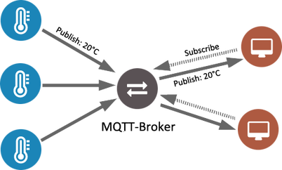
MQTT

Slide 74
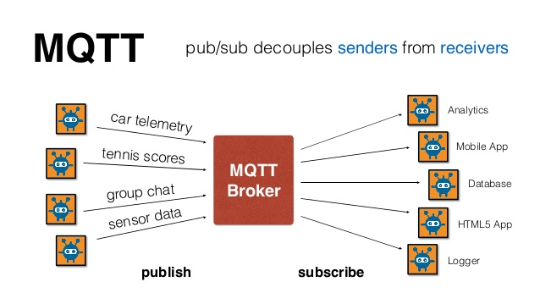
MQTT

Slide 75
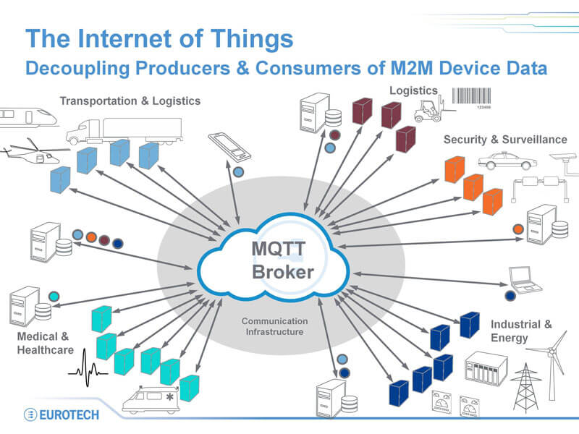
MQTT

Slide 76
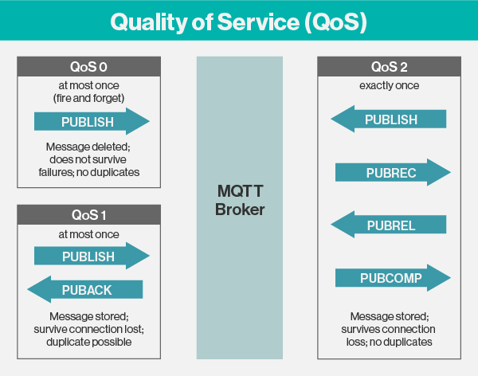
MQTT – Quality Of Service
http://www.steves-internet-guide.com/understanding-mqtt-qos-levels-part-1/

Slide 77
MQTT - Features
Open
Invented by IBM and Eurotech
MQTT client code (C and Java) donated to the Eclipse “Paho” M2M project
Reliable
Three quality of Service
Lean
Minimized on-the-wire format
Smallest possible packet size is 2 bytes
No application message header
Reduced complexity/footprint
Clients:c=30 kb java=100kb
Simple
Simple/minimal pub/sub message semantic s
Asynchronous (“push”) delivery
Simple set of verbs – connect,publish,subscribe and disconnect

Slide 78
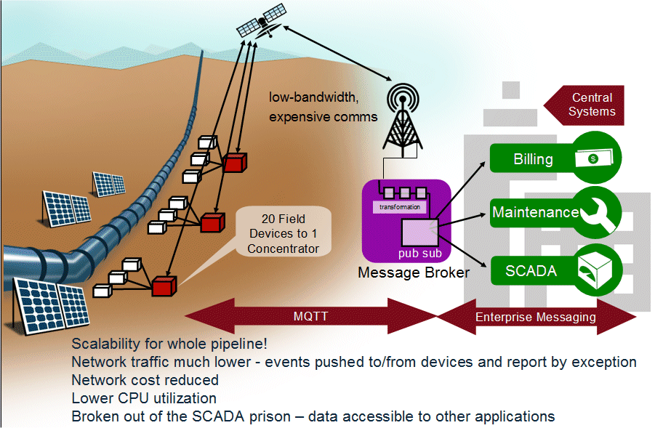
MQTT – Case Study

Slide 79
MQTT Brokers/Servers
Commercial
IBM
Software AG
dcSQuare
Open Source or free download
Mosquitto (https://mosquitto.org/). Client – Chrome add-on – MQTTLens
RSMB
ActiveMQ
Apollo
RabbitMQ
Mqtt.js
eMQTT

Slide 80
MQTT Hands-on
Installation of Mosquitto broker on windows
Reference - http://www.steves-internet-guide.com/
http://www.steves-internet-guide.com/mosquitto_pub-sub-clients/
2. MQTT FX
http://mqttfx.jensd.de/
http://www.jensd.de/apps/mqttfx/1.6.0/
3. https://mosquitto.org
4. My MQTT
5. MQTT Lens

Slide 81
CoAP overview
Inspired by HTTP (GET,POST,PUT, DELETE)
1-to-1 communication protocol
Lightweight and energy-efficient
Additional features on top of HTTP:
Observe
Discovery
QoS
Confirmable messages
Non-confirmable messages (fire and forget)

Slide 82
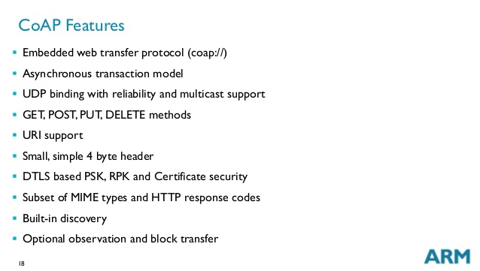
CoAP feature

Slide 83
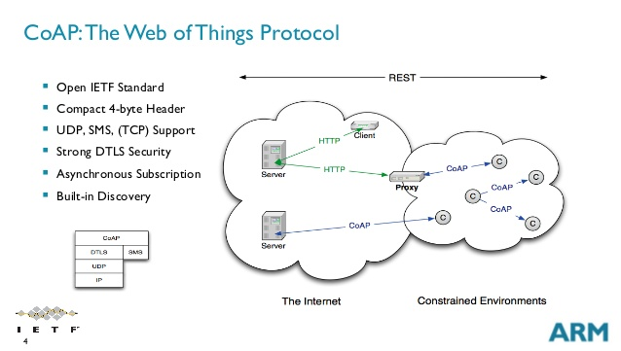
CoAP

Slide 84
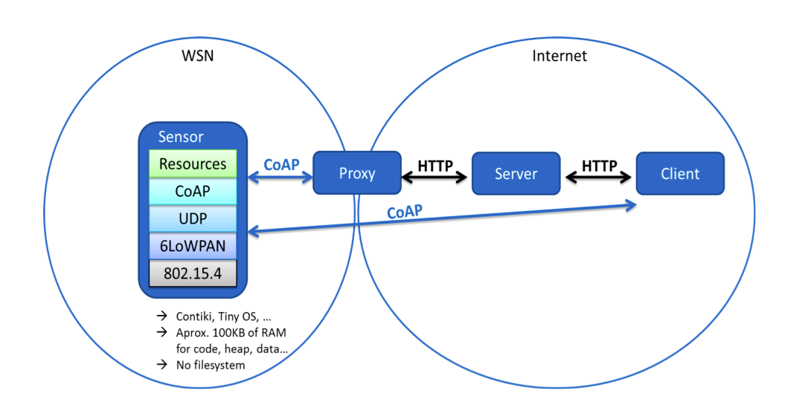
CoAP

Slide 85
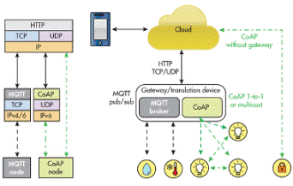
MQTT vs CoAP

Slide 86
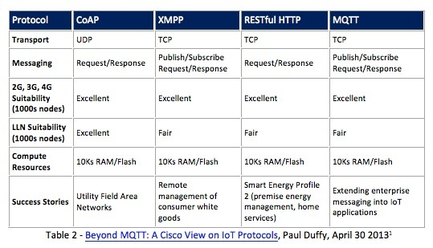
Comparison of IOT protocol

Slide 87
IoT Projects
https://electronicsforu.com/iot-projects-ideas
https://www.skyfilabs.com/blog/list-of-latest-iot-projects-for-engineering-students
https://create.arduino.cc/projecthub/projects/tags/iot
Automatic Watering System for Plants using Arduino
https://www.youtube.com/watch?v=nUHizmtyt74
https://howtomechatronics.com/arduino-projects/
https://electronicsforu.com/electronics-projects/smallest-iot-home-automation-esp8266-01
https://randomnerdtutorials.com/projects-arduino/

Slide 88
Thank You
Raghu Prasad
9845547471
www.kaushalya.tech
FB : https://www.facebook.com/raghuprasadkonandur/
Skill Up-Skill Re-Skill
Excellence in action

